Slide 1



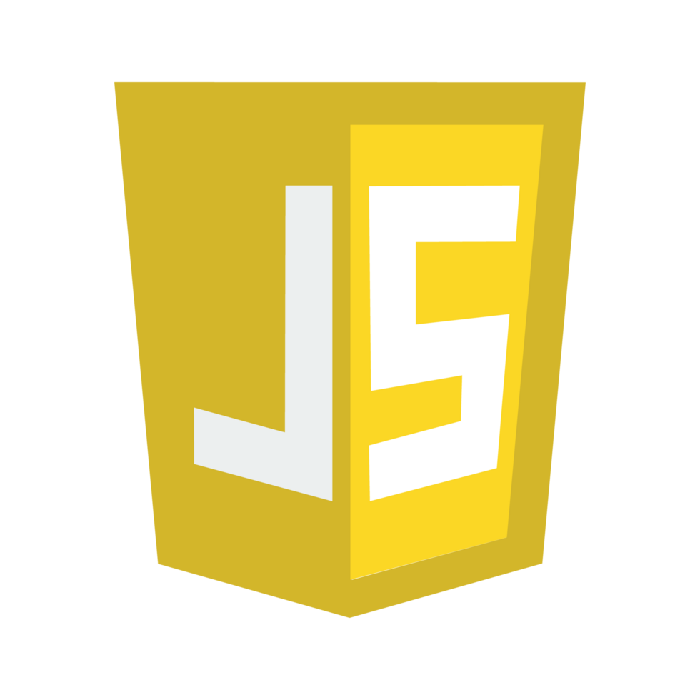


Lecture 11 :
Callbacks
Course - Web Development - II
-By
Instructor Name
By :
‹#›
welcome@krmangalam.edu.in
Sohna Road,Gurugram,Haryana 122103

Slide 2

| Table of Contents
Call Stack
Callback
Callback Hell
Handling Nested Callbacks
References.
The End.
‹#›

Slide 3

|
Have you ever wondered how JavaScript knows which function to run first and which one to run later? when you call one function inside another?
‹#›

Slide 4
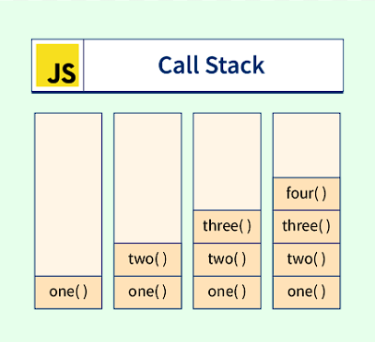
|
Have you ever wondered how JavaScript knows which function to run first and which one to run later? when you call one function inside another?
It’s all possible because of the Call Stack!
The Call Stack is like JavaScript’s memory notebook 📒
It helps JavaScript keep track of what it’s doing right now and what to do next.
‹#›

Slide 5
| Call Stack
The Call Stack is a mechanism in JavaScript used to keep track of function calls—which function is currently being run, and which functions are waiting to run.
It follows LIFO (Last In, First Out)—the last function called is the first one to finish.
‹#›

Slide 6
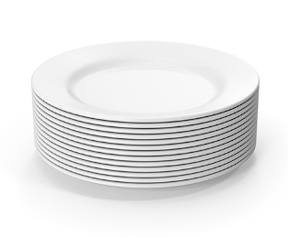
| Call Stack
Think of a Stack – Like a Stack of Plates 🍽️
Out
Imagine this:
You’re in a kitchen, and you're stacking plates one on top of another.
When you add a plate, you always put it on the top.
When you take a plate, you also take it from the top.
This is called LIFO – Last In, First Out
The last plate you put is the first one you take out.
In
‹#›

Slide 7
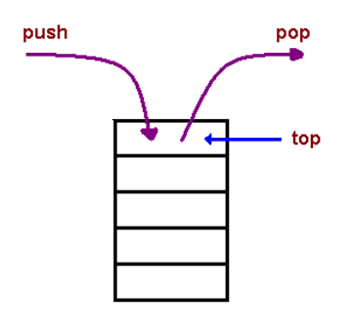
| Call Stack
Think of a Stack – Like a Stack of Plates 🍽️
Just like the Call Stack in JavaScript:
When a function is called, it gets pushed (added) on top of the stack.
When the function is done, it gets popped (removed) from the top.
Fun 5
Fun 5
Fun 4
Fun 3
Fun 2
Fun 1
‹#›

Slide 8
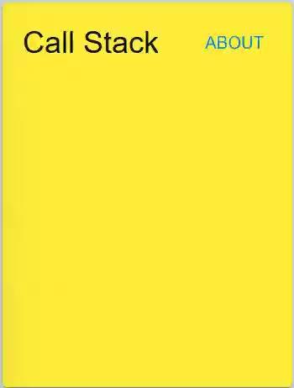
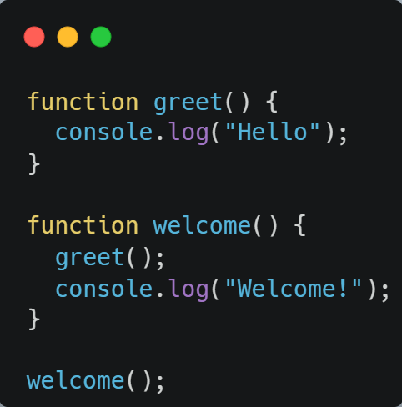
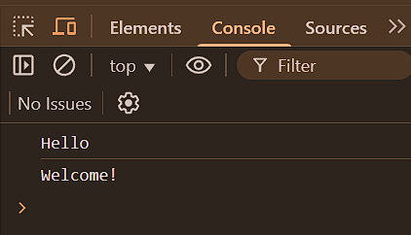
| Call Stack
‹#›

Slide 9

| Coding Questions
1. Visualizing the Call Stack
Task : Write three functions: first, second, and third. The first function should call the
second function, and the second function should call the third function. Inside each
function, log a message indicating which function is running. Finally, call the first
function to start the chain.
‹#›

Slide 10
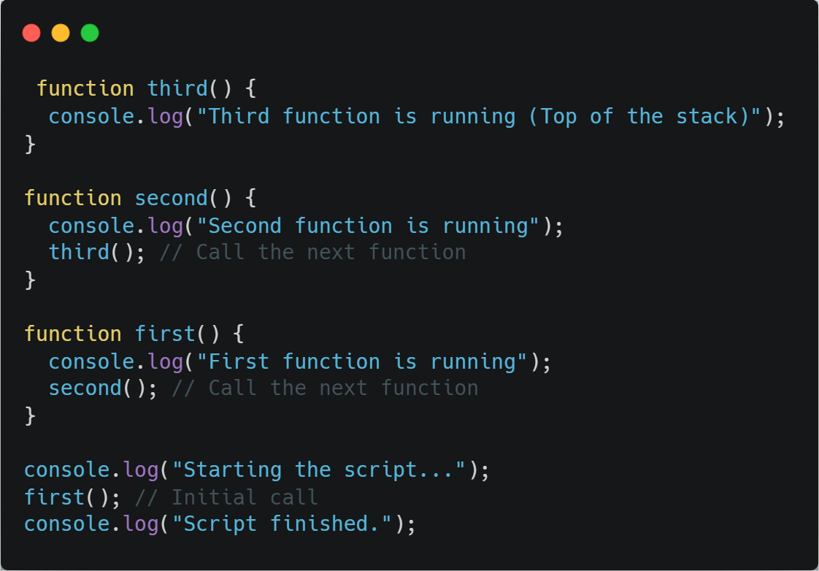
| Coding Questions
Solution :
‹#›

Slide 11
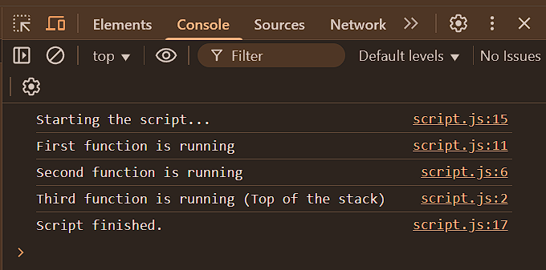
| Coding Questions
Output :
‹#›

Slide 12
|
Have you ever wondered When we write asynchronous code like setTimeout JavaScript does not wait and run the next line
‹#›

Slide 13
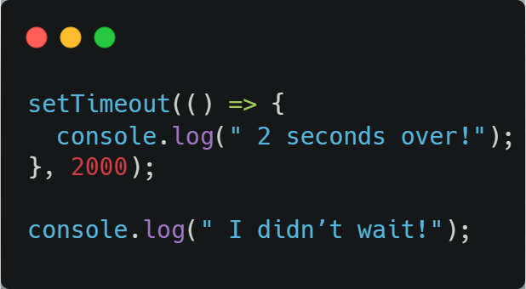
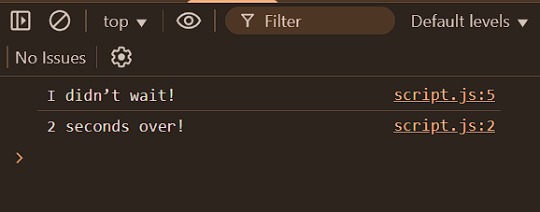
|
Have you ever wondered When we write asynchronous code like setTimeout JavaScript does not wait and run the next line
This code did not wait for async code
Async code
‹#›

Slide 14
|
But if we want JavaScript to wait until the asynchronous code is finished, and then run the next line — how do we do that?
‹#›

Slide 15
|
But if we want JavaScript to wait until the asynchronous code is finished, and then run the next line — how do we do that?
That’s where Callback Functions come in!
A callback function is a function that you give to another function to use later.
So when we do something that takes time (like waiting), we use a callback to say: When you're done, run this function!
That’s how we handle async (slow) code —
‹#›

Slide 16

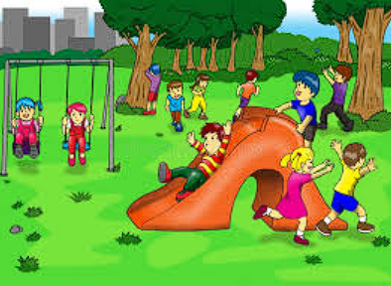
| Callback function()
Analogy :
You come home from school.
Mom says: First, finish your homework. Then you can
go to the playground.
You sit down and start working. Homework takes some time — about 2 minutes
When you finally finish, you shout : "Homework done!"
Then, as promised — "Now going to the playground!"

Slide 17
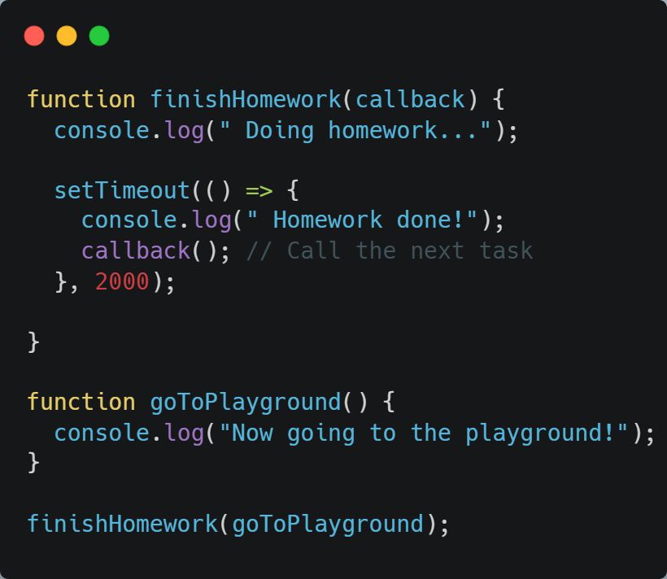
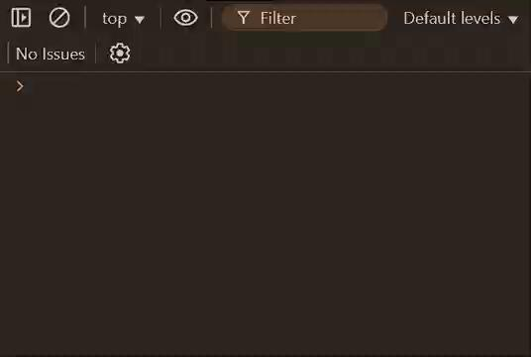
| Callback function()
Callback Function

Slide 18
|
Have you ever wondered… What happens when we have to do many asynchronous things — one after another, and each must wait for the previous one to finish?
‹#›

Slide 19
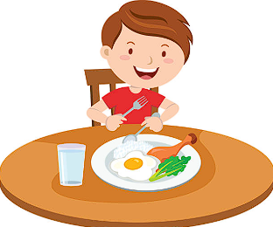
|
Have you ever wondered… What happens when we have to do many asynchronous things — one after another, and each must wait for the previous one to finish?
You want to:
✅ Finish homework
🍽️ Eat dinner
⚽ Go to the playground
All tasks take time and are async code — so each
is written using setTimeout
‹#›

Slide 20
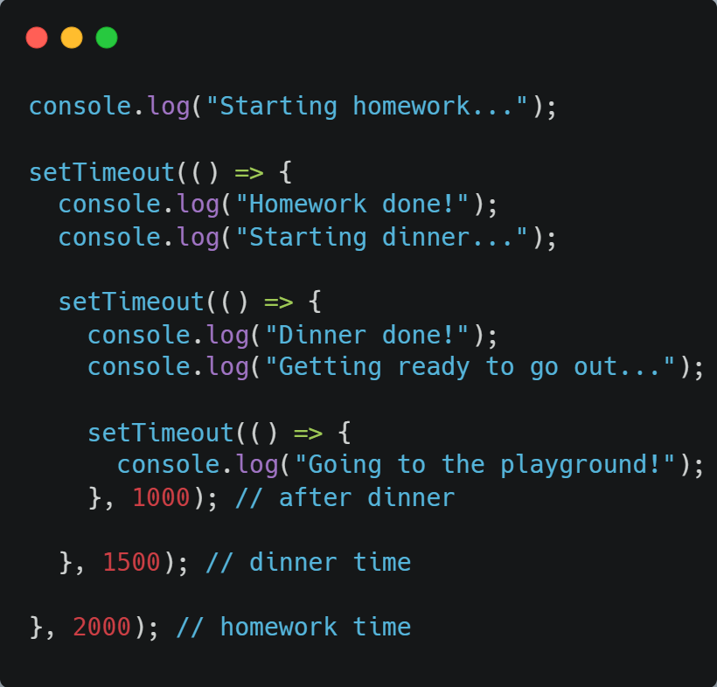
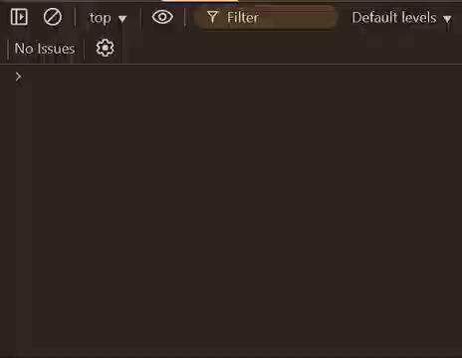
| Callback Hell
Callback Hell

Slide 21
| Callback Hell
It goes deeper and deeper → Right side keeps growing!
It looks like a pyramid — and we call this the Pyramid of Doom.

Slide 22
| Callback Hell Problems
Hard to read — code becomes confusing
Hard to fix — if something breaks, it’s tough to know where
Error handling is messy — we need try/catch or if (error) inside every level
One missing } or ) — everything crashes!

Slide 23
| Coding Questions
1. Identifying Callback Hell
Task :
Look at the code below, which simulates making a pizza. Describe why this code is an example of "Callback Hell" and difficult to manage. You do not need to run it, just analyze it.
‹#›

Slide 24
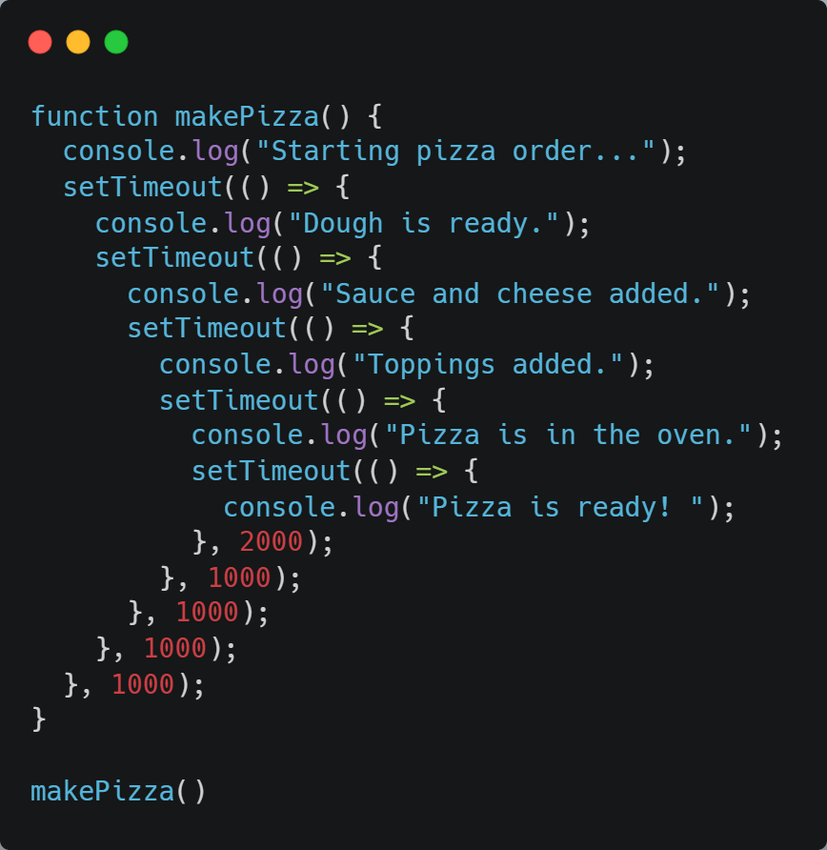
| Coding Questions
Solution :
‹#›

Slide 25
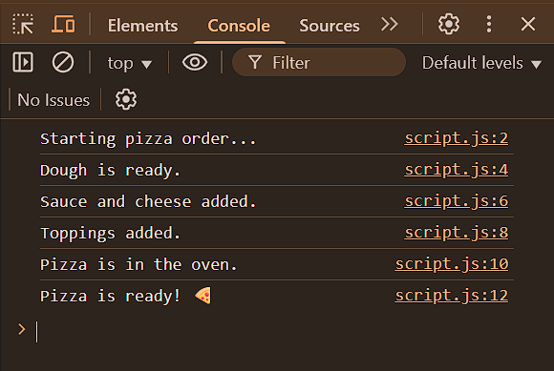
| Coding Questions
Output :
‹#›

Slide 26

| Handling Callback Hell
Congratulations! We can give names to our callback functions.
This makes our code cleaner, more organized, and we don’t need to scroll to the right!
It’s a small trick to avoid the mess of callback hell — But It’s still not perfect, but at least we can breathe while reading it!

Slide 27
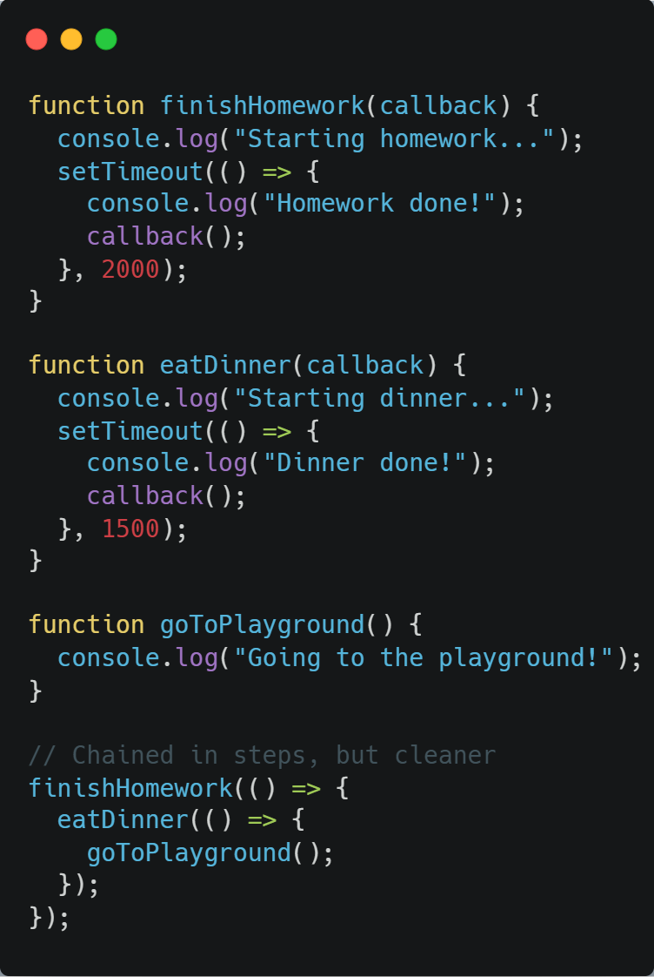
| Handling Callback Hell

Slide 28
| Check Your Understanding
Question : What is the main purpose of the Call Stack in JavaScript?
Options : a) To store variables.
b) To keep track of which function is currently being executed.
c) To schedule tasks to run in the future.
d) To store a list of all arrays in the code.
Answer : b) To keep track of which function is currently being executed.
Explanation:
The Call Stack is a data structure that records where the program is in its execution. When a function is called, it's pushed onto the stack. When it finishes, it's popped off.
‹#›

Slide 29
| Check Your Understanding
Question : What is "Callback Hell"?
Options : a) A function that calls itself infinitely.
b) A situation where callbacks are nested deeply within other callbacks, making the code hard to read.
c) A callback function that produces an error.
d) Using more than three callbacks in a single file.
Answer : b) A situation where callbacks are nested deeply within other callbacks, making
the code hard to read.
Explanation:
Also known as the "Pyramid of Doom," it describes a code structure that is difficult to read and debug due to multiple levels of indentation from nested callbacks.
‹#›

Slide 30
| Check Your Understanding
Question : When a function is called in your code, where is it placed in the Call Stack?
Options : a) At the bottom of the stack.
b) In the middle of the stack.
c) At the top of the stack.
d) It is placed in the Callback Queue first.
Answer : c) At the top of the stack.
Explanation:
The Call Stack operates on a "Last-In, First-Out" (LIFO) principle. The most recently called function is always at the top.
‹#›

Slide 31
| Check Your Understanding
Question : Given the function call process(calculate()), which function is pushed onto the
Call Stack first?
Options : a) process
b) calculate
c) They are pushed on at the same time.
d) The global function.
Answer : b) calculate
Explanation:
JavaScript must evaluate a function's arguments before it can call the function itself. Therefore, calculate() must be executed and return a value first. It is pushed onto the stack, runs, is popped off, and then process() is pushed onto the stack with the result from calculate().
‹#›

Slide 32
| Check Your Understanding
Question : What is a common and immediate strategy to make nested callback code more
readable and manageable?
Options : a) Using only arrow functions.
b) Putting all callbacks into a single, large function.
c) Converting the nested anonymous functions into separate, named functions.
d) Adding more comments.
Answer : c) Converting the nested anonymous functions into separate, named functions.
Explanation:
Extracting callbacks into named functions flattens the "pyramid" structure, making the code more modular, readable, and easier to debug. This is a direct way to handle Callback Hell.
‹#›

Slide 33
| References
MDN Web Docs : Comprehensive and official documentation for JS. 🔗https://developer.mozilla.org/en-US/docs/Web/JavaScript
W3Schools – JS Tutorial : Beginner-friendly JS tutorials with examples and interactive editors. 🔗 https://www.w3schools.com/js/
JavaScript.info - A comprehensive tutorial-style website that covers core JavaScript concepts in depth.
🔗https://javascript.info/
‹#›

Slide 34
Thanks
For
Watching
Course - Web Development - II
‹#›
welcome@krmangalam.edu.in
Sohna Road,Gurugram,Haryana 122103

